Slide 1
Internship Studio’s Ethical Hacking Internship Project
By: SHREYA PANDEY
Email: csengineerspandey@gmail.com

Slide 2
TASK - 02
Finding vulnerabilities from a given website

Slide 3
Using OWASP ZAP Snapshots of vulnerabilities found

Slide 4
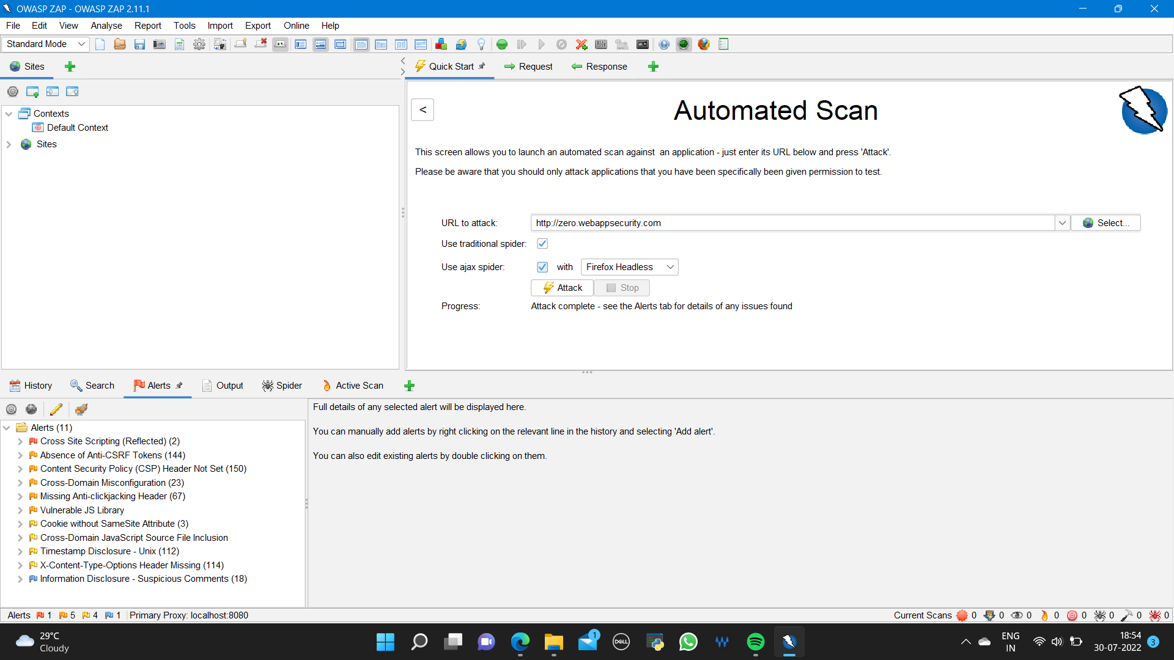

Slide 5
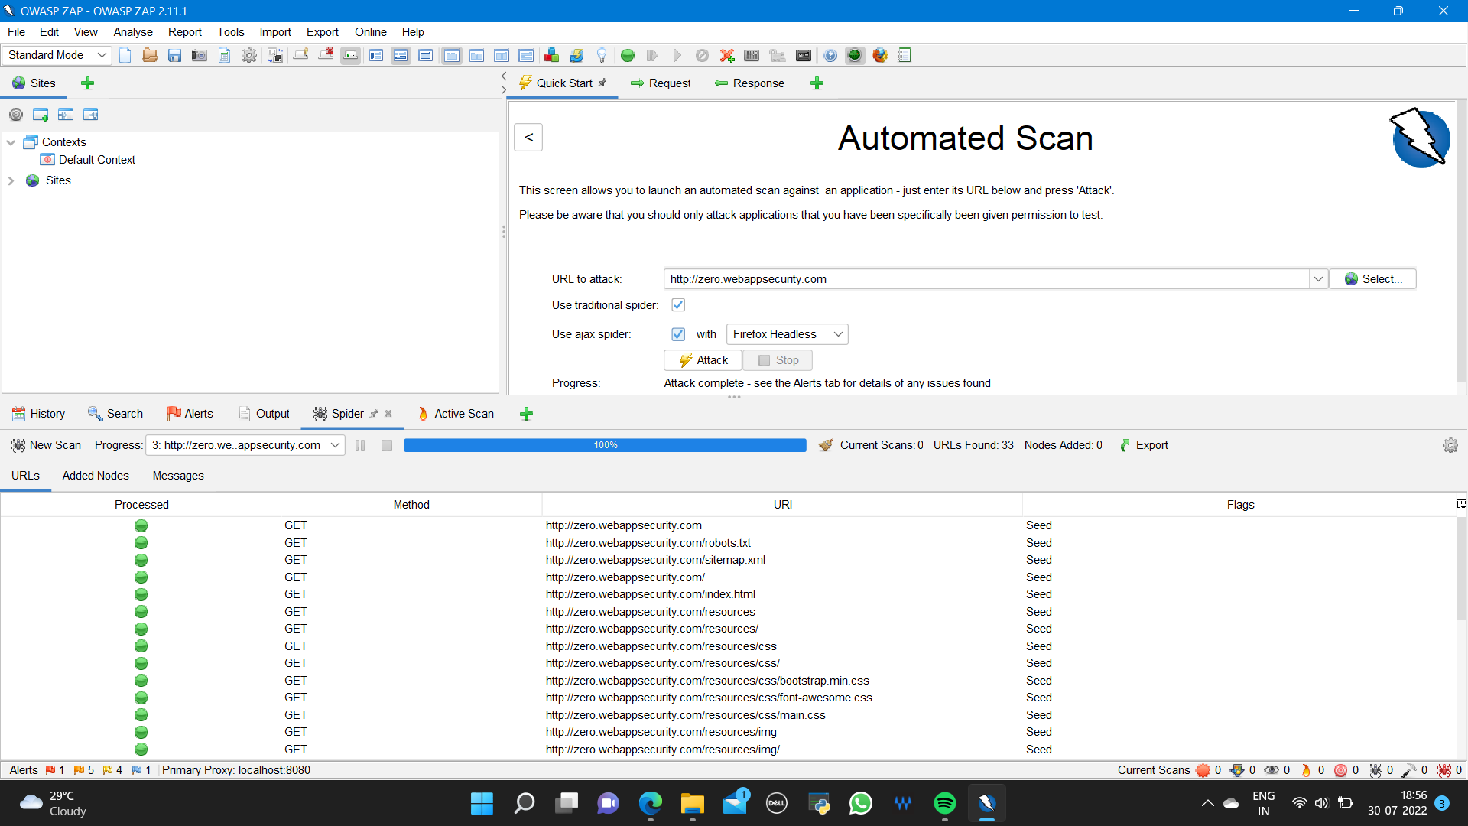

Slide 6
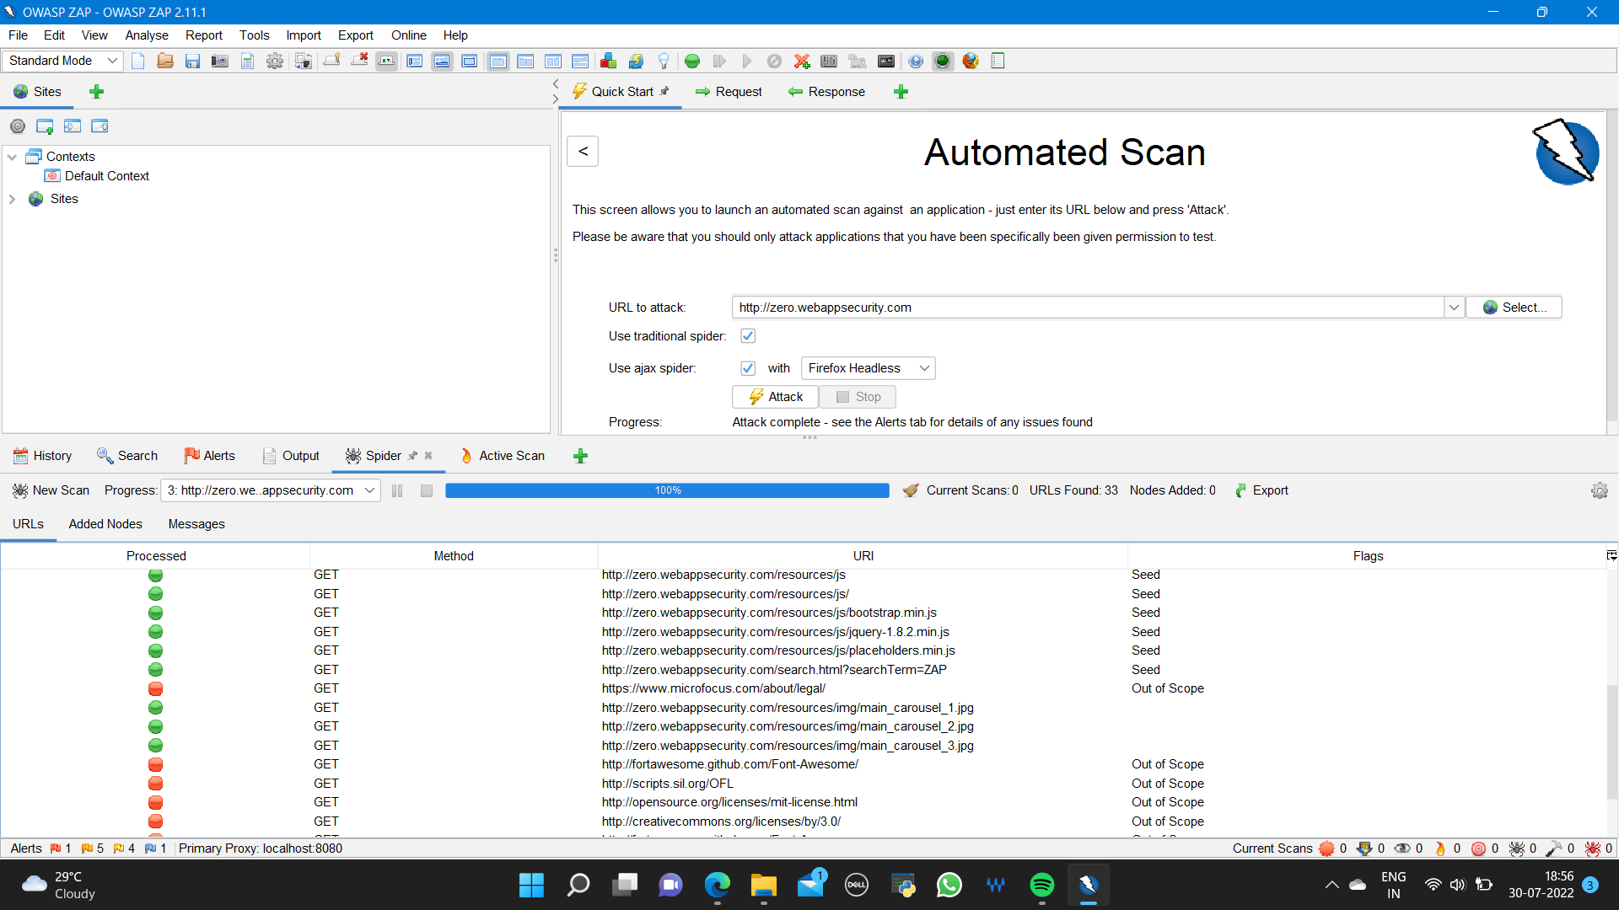

Slide 7
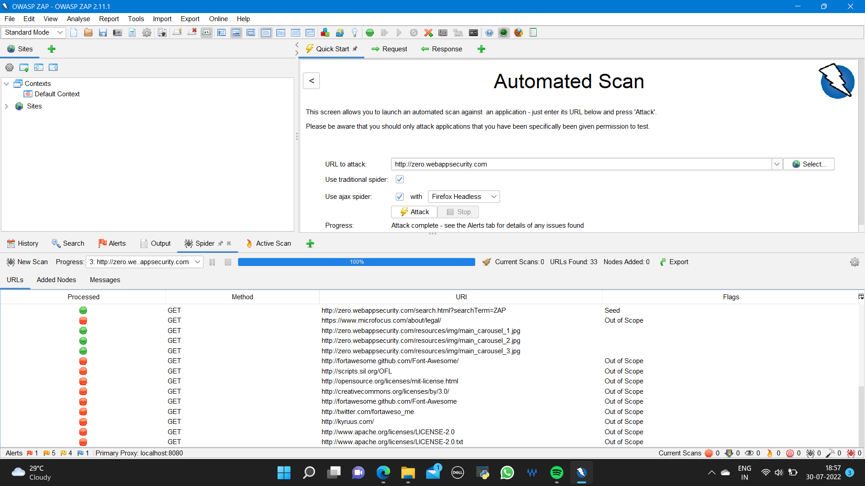

Slide 8
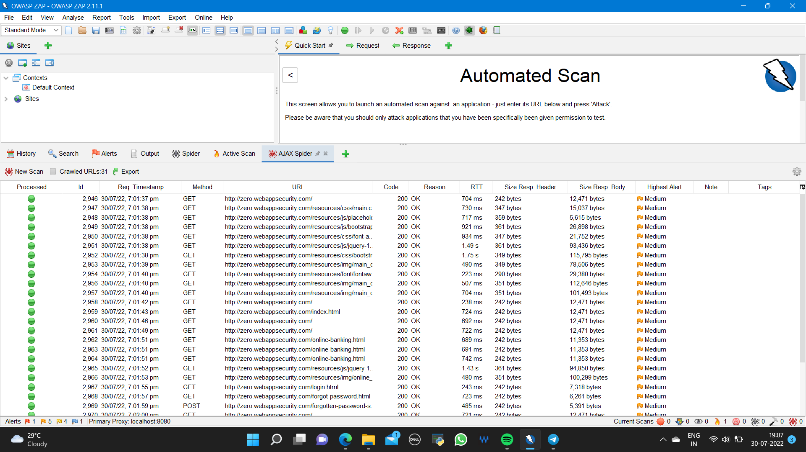

Slide 9
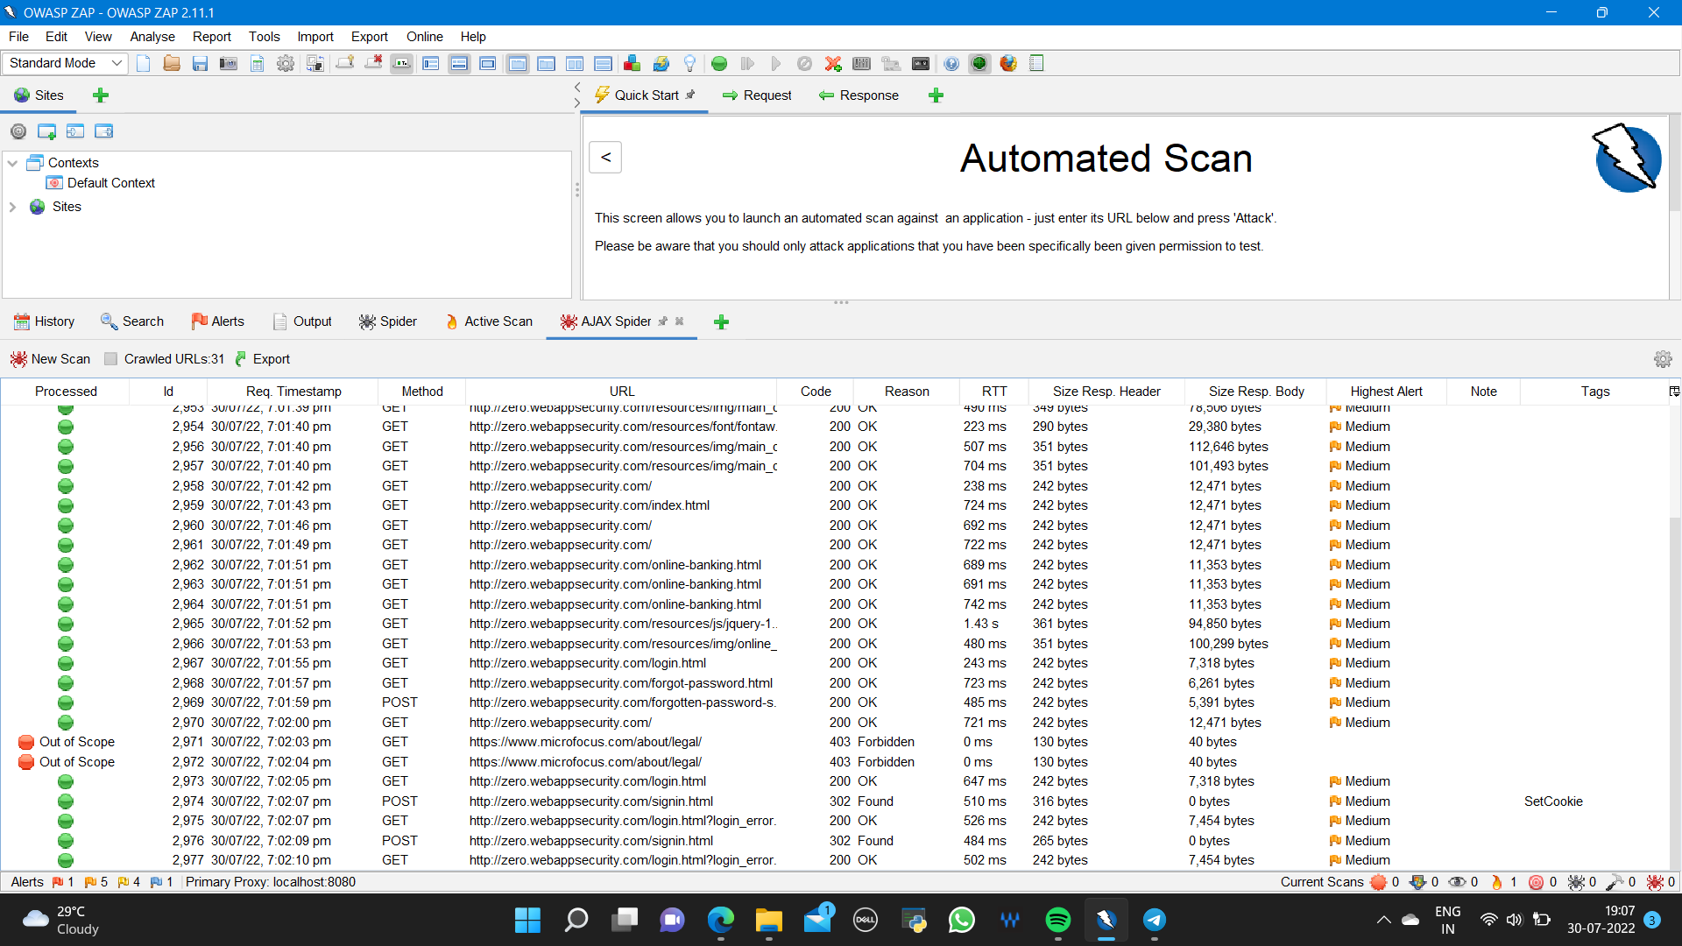

Slide 10
Alerts description in the ZAP report

Slide 11
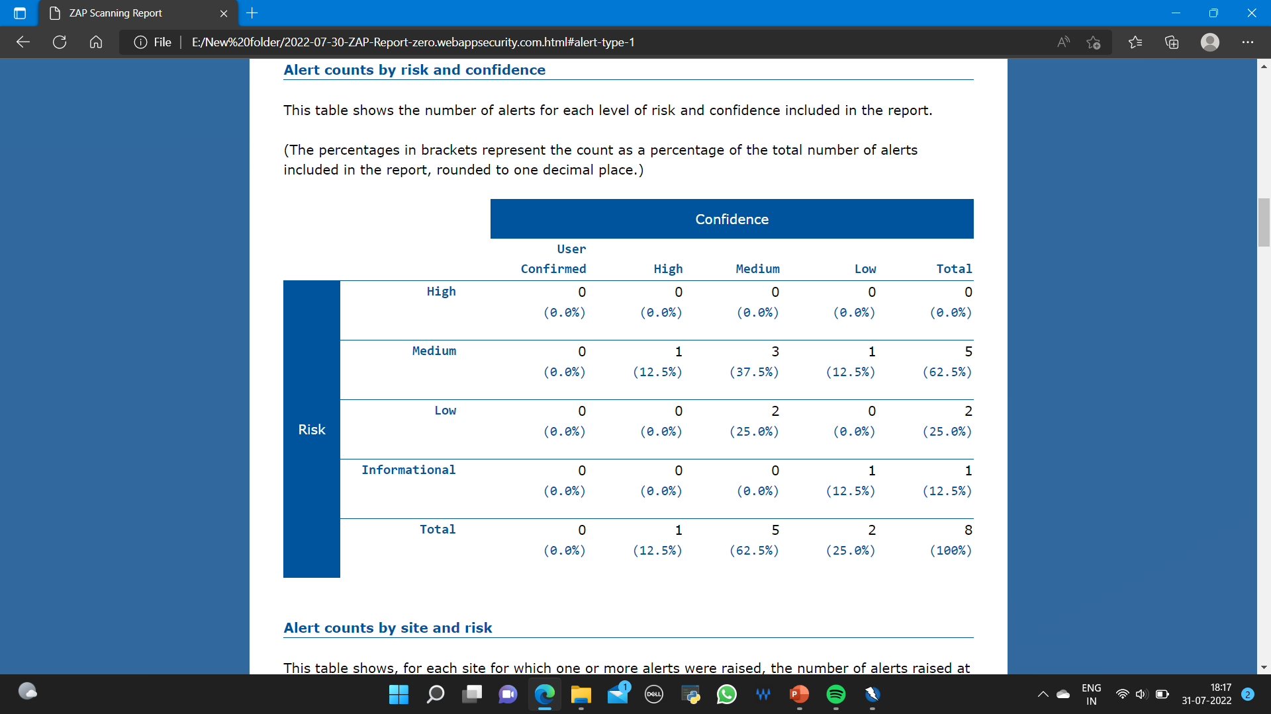
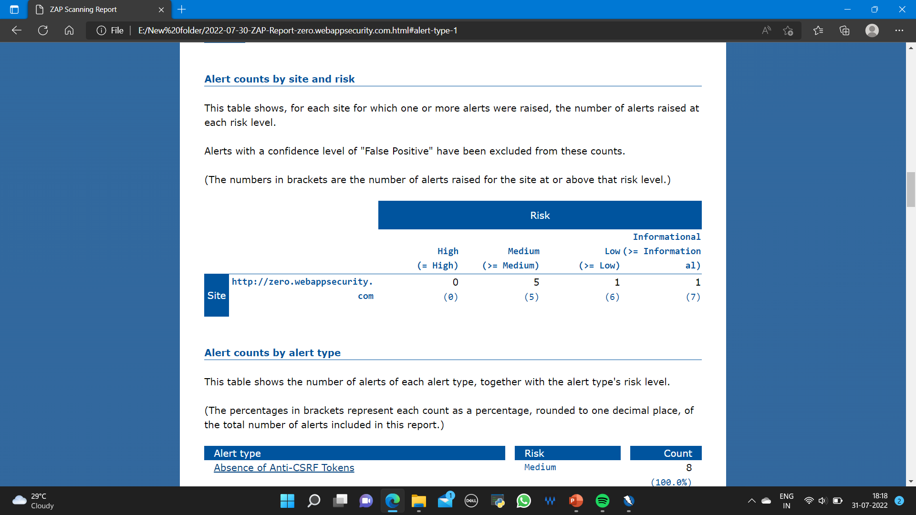

Slide 12
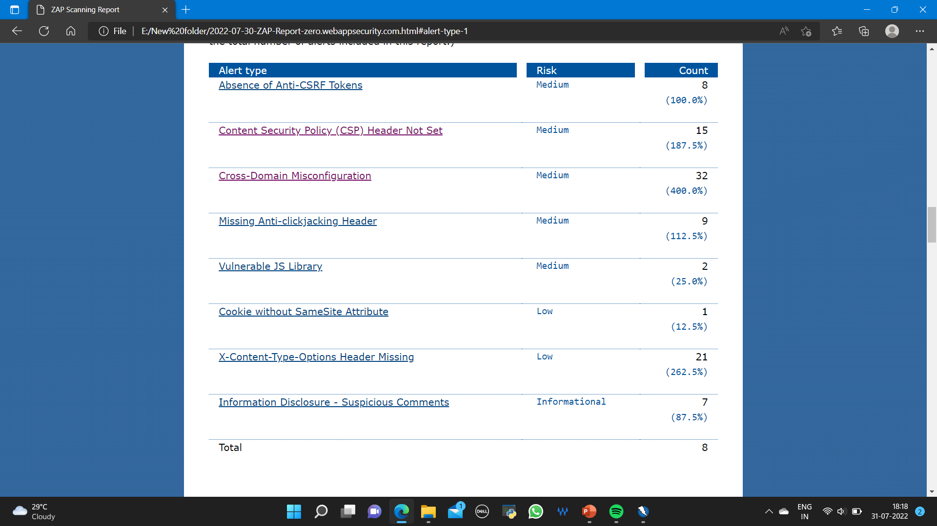
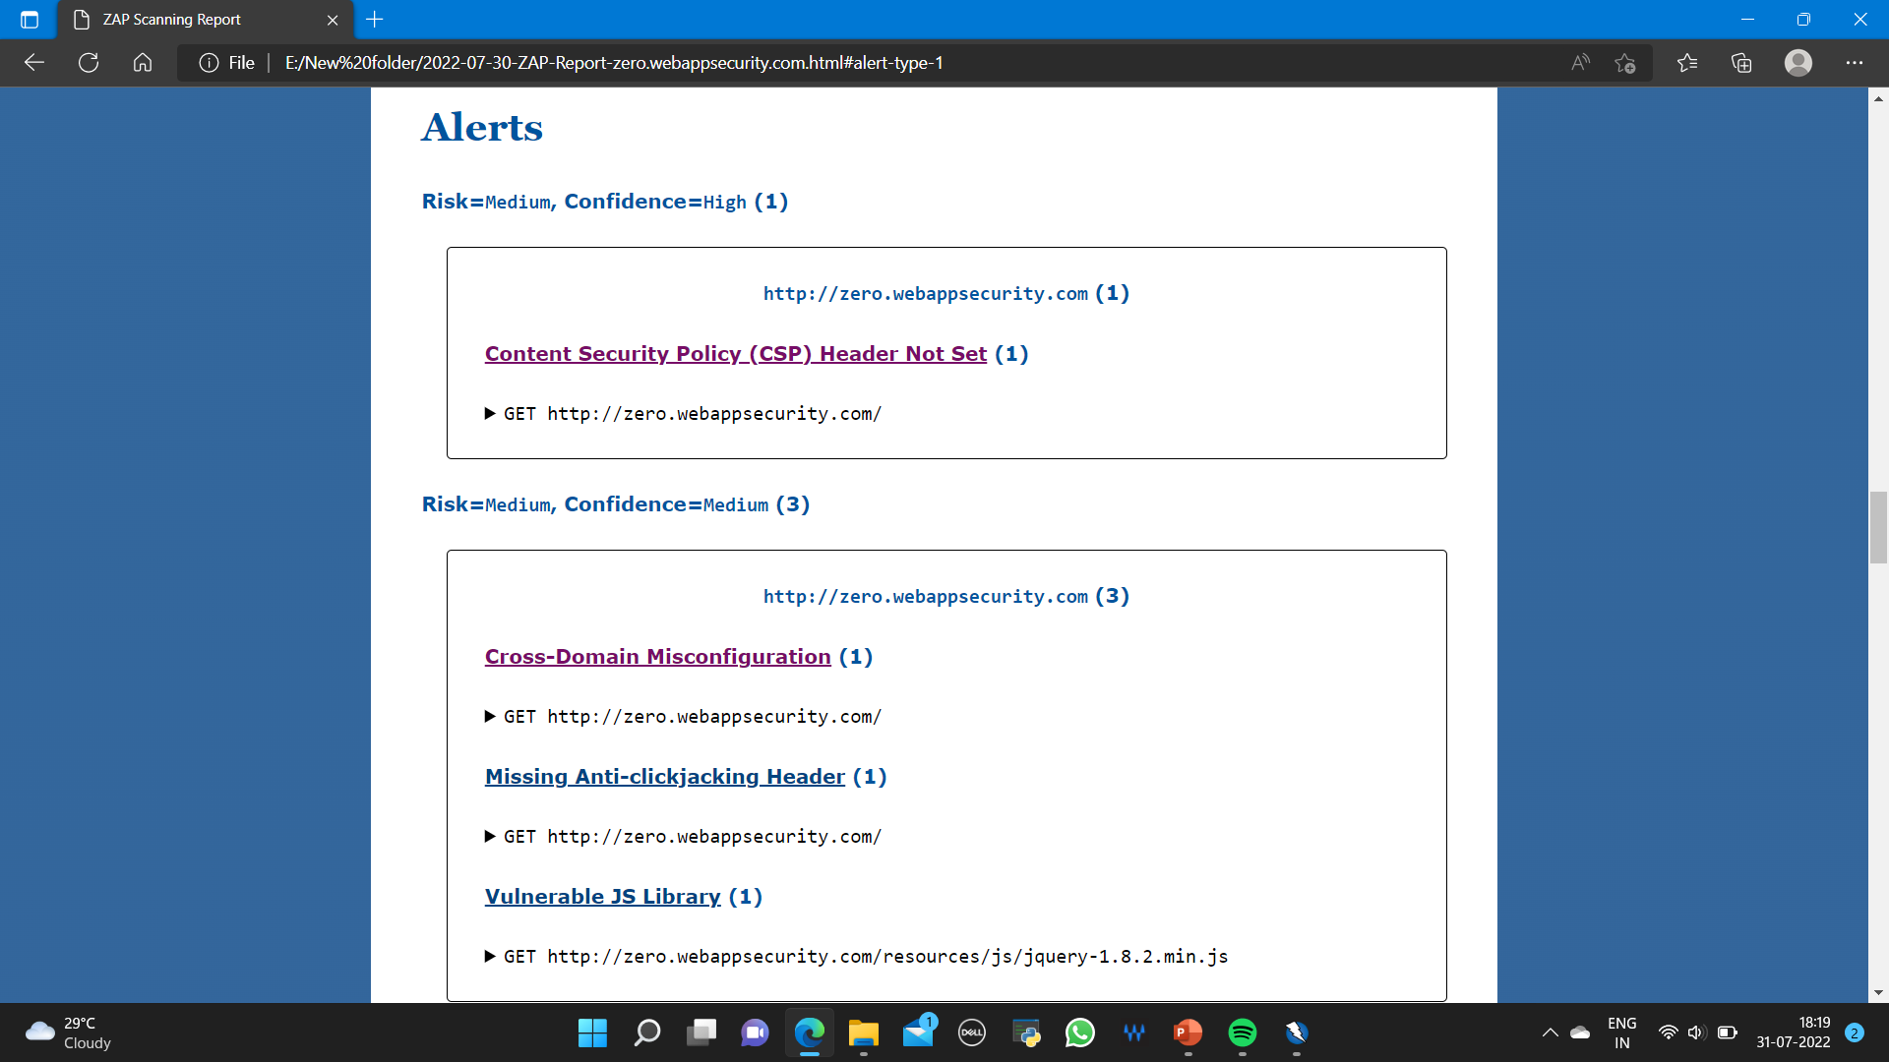

Slide 13
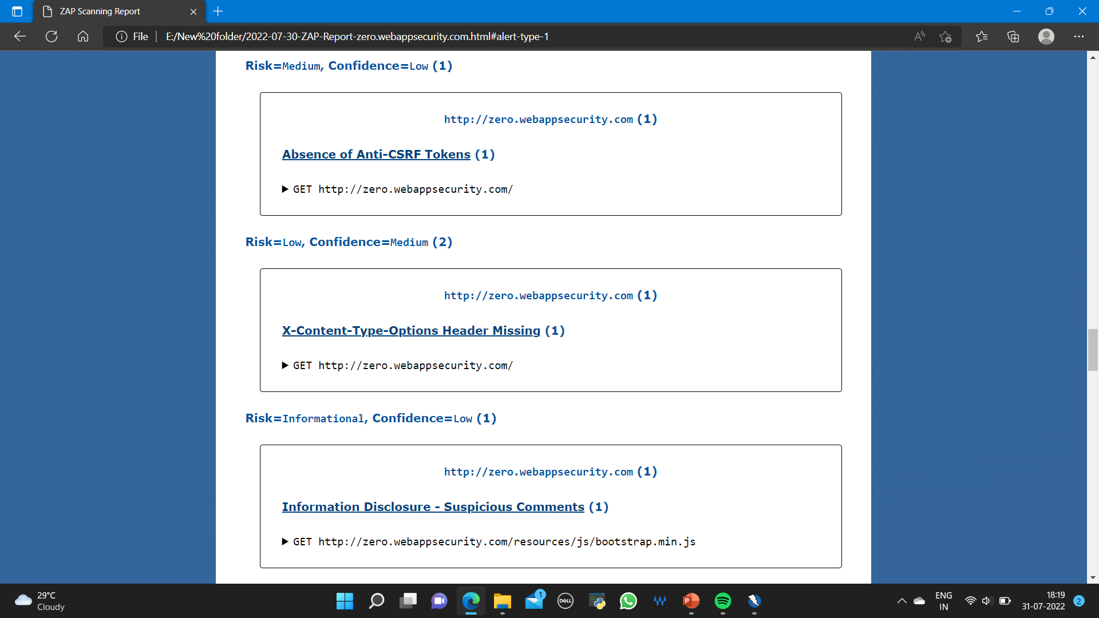

Slide 14
REPORT
Website: http://zero.webappsecurity.com/
Website name: Zero Bank’s Website
Tool used to find vulnerabilities: OWASP ZAP
The website has the possibility of Cross-Site Scripting (XSS) via remote inclusion which allows an unknown person to make undesirable changes to it such as changes in the appearance of website, stealing cookies and essential information etc.
As this website uses HTTP which are less secure making it easily possible for black hat or grey hat hackers to penetrate into the network, destroy all the data by breaching into it and do many more malicious activities which can be harmful.

Slide 15
Solutions
Using “web application firewall” in order to alert the developer about the attack in advance by filtering the bots
Make sure that the website specifies UTF-8 charset in the headers
Validation of input when it is arrived should be ensured
When the data is output for user then it should be encoded properly
Escaping the user input so that it cannot be interpreted in malicious manner

